Slide 1
Delivering Successful Business Outcomes with Catalyst
Exercise workbook
Instructions:
Download this workbook to use for the course exercises and draft your responses in the allocated slide.

Slide 2
Introducing Catalyst

Slide 3
Introducing Catalyst
Select the appropriate playbook for an initiative
Response:

Slide 4
Introducing Catalyst
Select the appropriate phase(s) and engagement type for an initiative
Response:

Slide 5
Introducing Catalyst
Describe how Anypoint Global Bank can deliver initiatives with Catalyst
Response:

Slide 6
Leveraging Catalyst
Knowledge Hub

Slide 7
Leveraging Catalyst Knowledge Hub
Choose the appropriate core asset
Response:

Slide 8
Leveraging Catalyst Knowledge Hub
Decide on a playbook versus a delivery approach
Response:

Slide 9
Architecting in a Catalyst Context

Slide 10
Architecting in a Catalyst Context
Describe stakeholder roles for Anypoint Global Bank
Response:

Slide 11
Architecting in a Catalyst Context
Describe the Catalyst architecting principles
Response:

Slide 12
Architecting in a Catalyst Context
Draw a system landscape diagram for the Anypoint Global Bank case study.
Response:
Diagram Resources
Integration Platform
[Application]
[Salesforce System]
[Legacy System]

Slide 13
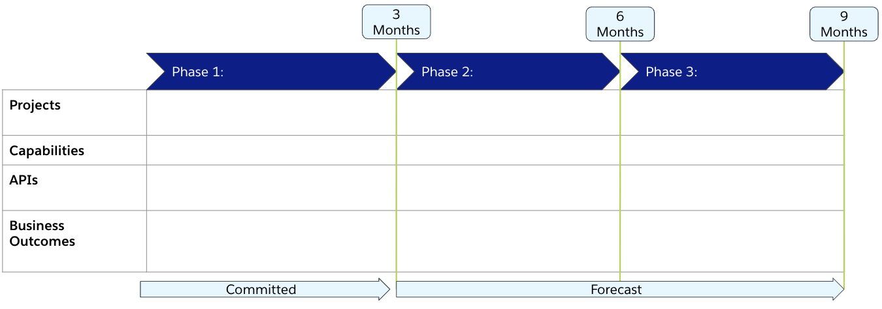
Architecting in a Catalyst Context
Build an architecture roadmap and backlog for Anypoint
Global Bank

Slide 14
Architecting in a Catalyst Context
Critique the engagement scope
Response:

Slide 15
Architecting to Catalyst Principles

Slide 16
Architecting to Catalyst Principles
Create a Goal/Objective/Service diagram
Diagram Resources
[Goal]
[Capability]
[Project]
[API]

Slide 17
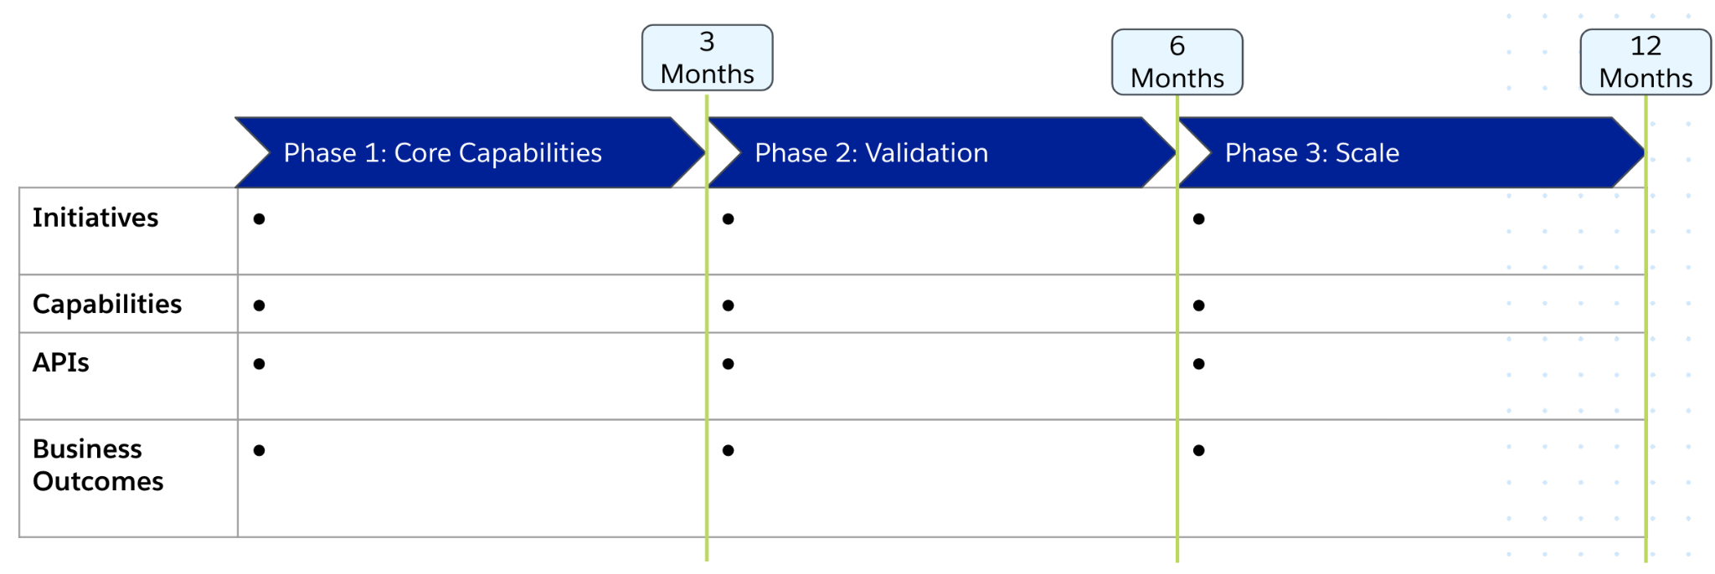
Architecting to Catalyst Principles
Create a strategic roadmap

Slide 18
Architecting to Catalyst Principles
Create a product-oriented organization
Response:

Slide 19
Realizing Business Outcomes

Slide 20
Realizing Business Outcomes
Define business outcomes for Anypoint Global Bank
Response:
Business Outcome 1
Objective:
Business Initiative:
Technology Use Case:
Value:
Business Outcome 2
Objective:
Business Initiative:
Technology Use Case:
Value:
Business Outcome 3
Objective:
Business Initiative:
Technology Use Case:
Value:
Business Outcome 4
Objective:
Business Initiative:
Technology Use Case:
Value:
Business Outcome 5
Objective:
Business Initiative:
Technology Use Case:
Value:
Business Outcome 6
Objective:
Business Initiative:
Technology Use Case:
Value:

Slide 21
Realizing Business Outcomes
Define business and platform capability benefits (1/2)
Response:
Business Capability Benefits
Platform Capability Benefits

Slide 22
Realizing Business Outcomes
Define business and platform capability benefits (2/2)
 | Strategic goals | IT initiatives | Integration use cases | Catalyst approach / platform benefits | Business value
Business capability benefits
Platform capability benefits

Slide 23
Realizing Business Outcomes
Define Anypoint Global Bank’s initial KPI set
Name | Description | Units of Measure | Collection Points/Means | Scope | Visualization | Goal State

Slide 24
Implementing a
Center for Enablement

Slide 25
Implementing a Center for Enablement
CoE vs C4E: Address CoE concerns
Response:

Slide 26
Implementing a Center for Enablement
Define C4E team structure, roles, and responsibilities
Core Roles
Extended Roles
Supporting Roles
Diagram
Diagram Resources
[Core Role]
[Extended Role]

Slide 27
Implementing a Center for Enablement
Considerations when building reusable assets
Response:

Slide 28
Positioning & Reframing
with Catalyst

Slide 29
Positioning & Reframing with Catalyst
Map supporters and resisters for positioning for an organization
Anypoint Global Bank
CEO
CIO
Business Owner
Enterprise Architect
Project Manager
Product Owner
 | Supports the change
 | Neutral
 | Opposed
Solution Architect
Dev Lead
Test Lead
Developers
Testers

Slide 30
Positioning & Reframing with Catalyst
Create a stakeholder map for an engagement from the given information
Stakeholder | Quadrant
CIO
Business Owner
Project Manager
Enterprise Architect
Solution Architect
Development Lead
Test Lead
Developers
Testers
Keep Satisfied | Manage Closely
Monitor | Keep Informed
Power
Interest

Slide 31
Positioning & Reframing with Catalyst
Determine stakeholder engagement strategy based on their concerns and motivations, and degree of support and influence
Stakeholder | Concerns | Engagement Strategy
CIO
Enterprise Architect
Project Manager

Slide 32
Positioning & Reframing with Catalyst
Propose the most fitting Catalyst engagement to the customer for a given scenario
Business Outcomes
Technology Delivery
Organization Development

Slide 33
Positioning & Reframing with Catalyst
Identify deviations from a Catalyst approach
Response:

Slide 34
Congratulations!
You’ve completed the exercise workbook.

